Slide 1
Creating ADT & Introduction of OOP
CSC1003

Slide 2
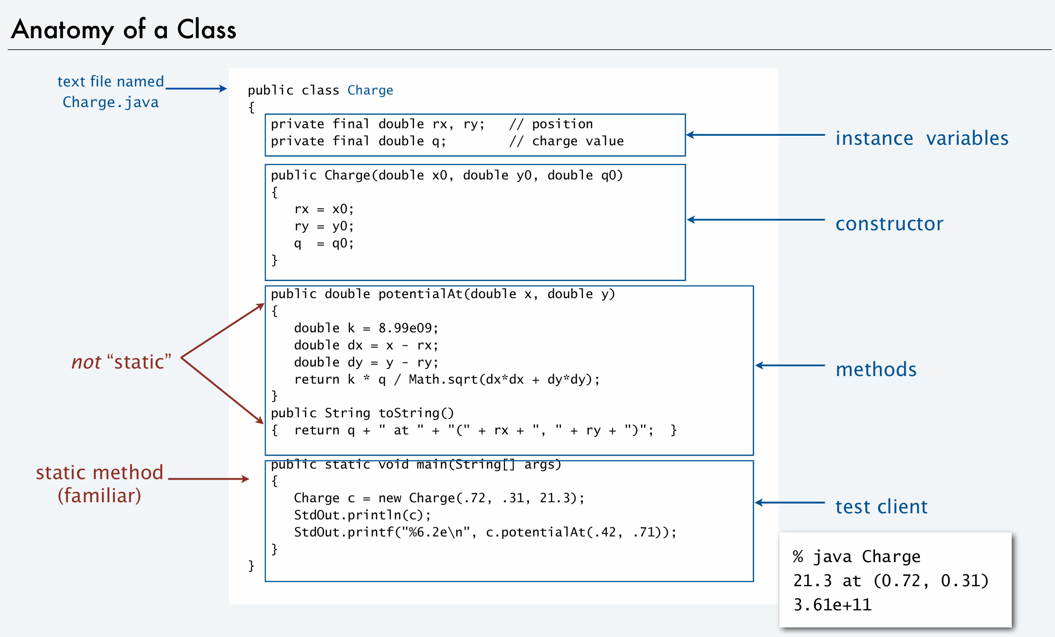
Static (reference only)
Static methods cannot call non-static members.
Static member variables and methods belong to the class.

Slide 3
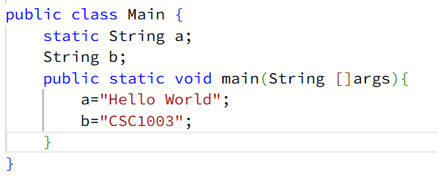

Slide 4
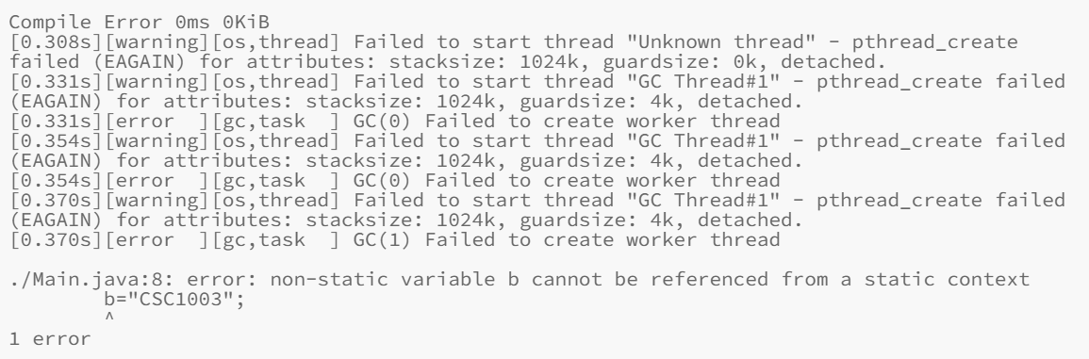

Slide 5
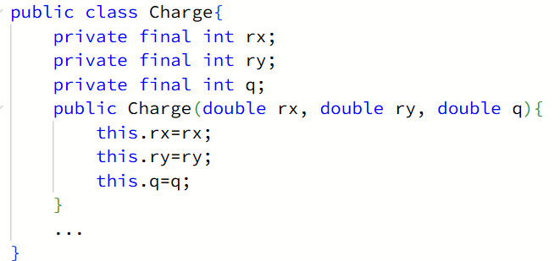
Keyword: this (reference only)
Sometimes we can also write it as:

Slide 6
Encapsulation(reference only)
Public: accessible from any other class
Private: accessible only within the class they are declared in
Final: can’t be modified, needs initialization
Q:Why do we need encapsulation?

Slide 7
Inheritance
Polymorphism
Abstraction
Interface
Learn more in CSC1004!

Slide 8
Sample: Creating Points
Requirements: Creating ADT called Point, where you should create methods including:
1.getX() and getY().
2.coordinate, which should return its coordinate in the form of “x=…,y=,,,”.
3.tan, which should return the slope of the line created by two points(if valid).
4.distance, which should return the distance between two points.
5.area, which should return the area of a triangle created by three points(if valid).

Slide 9
